Slide 1
Sensor-fusion Based Group-level Emotion Classification via Reinforced Self-training
@進捗報告
M2 LIU YI(21860638)
情報科学域
指導教員 下川原英理
Notes:
Hello,everyone.
Today,My presentation title is <Sensor Fusion-based Emotion Classifcation In Virtual Reality Using Machine Learning>.

Slide 2
Introduction
Complex, compound emotions often arise
in our daily lives
For instance, happily surprised and angrily surprised are two distinct compound emotion categories
General classification models may be less effective in recognizing complex, compound emotional conditions.
Individual differences and environment have an impact on the performance of biometric information
We try to solve these problem

Slide 3
Why emotion and dialogue mood？
VRにおける、複数人の対話の雰囲気や個人の感情を把握して適切な介入を行うことで、コミュニケーションを円滑させる対話支援アバターの開発を目指す。
The goal is to develop a dialogue support avatar in VR
雰囲気工学では，多人数の会話場における雰囲気を分析す
ることや，複数の会話エージェントや会話ロボットによる人工的
な言語，非言語情報が作り出す会話場の雰囲気の分析を目指す

Slide 4
Shortcomings of the previous study
Shortcomings of the previous study
Insufficient amount of experimental data
individual differences appeared
The means of feature extraction of the data needs to be improved
Difficulty in confirming whether self-report accurately describe their own emotions
Collaborators exposed to VR for the first time tend to show excitement

Slide 5
Self-training and Reinforcement Learning Model
high-level/quality
labeled dataset
Matching Model
predict
low-level/quality
labeled dataset
train
predict
unlabeled dataset
reward
evaluation
Reinforcement Learning Policy Network
add pseudo
labeled instances
Do data selection
evaluation
via interaction with player
reward
Avater
Notes:
First, train emotion classification model using train set, then predict using low-level labeled dataset/unlabeled dataset
Policy Network will select the data from the low-level labeled dataset/unlabeled dataset based on the predict result
If the Policy Network selects high-quality samples, new model will get a better performance on validation set, and get reward.
If the Policy Network adopts the wrong policy, the model will get poor results and return negative rewards

Slide 6
Experiment実験
APP: VRChat
Participants: more than 20 groups of collaborators
Used Features: EEG, HRV<-ECG, Eye tracking, Acceleratorheadband),
audio features
Details:
3 people a group
One participant wear sensors and VR headset as a main talker
other two participants just wear VR headset and talk
Each conversation lasted approximately three minutes

Slide 7
对话结束后，用问卷评估三维情感，以及对话moriagaru的氛围程度
对数据进行预处理和特征抽出
训练低中高 效价匹配模型

Slide 8
Question
如何保证收集到高质量的情感数据以训练出高质量的Matching Model
要用什么Policy Network算法
reward和evaluation的平衡怎么办
VR中avater和player的交互方式怎么设计
avater的evaluation/reward策略怎么设计

Slide 9
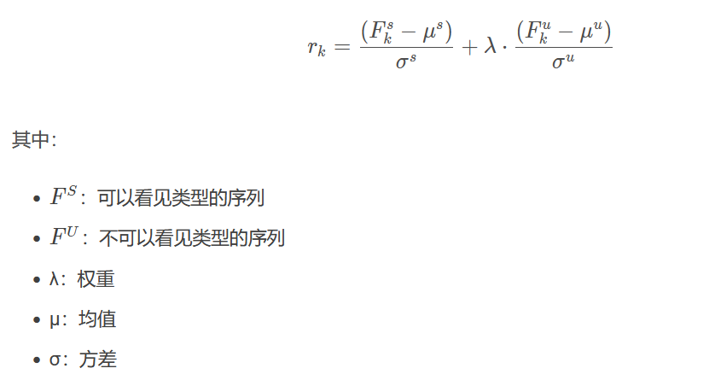
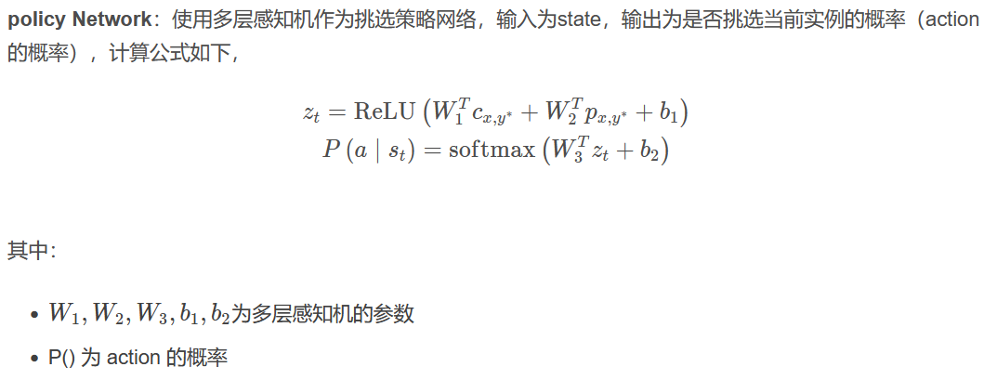
For Reinforcement Learning Network
(1)State:
preprocessed biological data and confidence point
(2)Action:
Two class, whether choose this sample
(3)Reward:
Based on the model’s performance on validation set
(4)Policy Network:
Input is State
Output is Action’s probability distribution
Notes:
First, train emotion classification model using train set, then predict using low-level labeled dataset/unlabeled dataset
Policy Network will select the data from the low-level labeled dataset/unlabeled dataset based on the predict result
If the Policy Network selects high-quality samples, new model will get a better performance on validation set, and get reward.
If the Policy Network adopts the wrong policy, the model will get poor results and return negative rewards

Slide 10
利用自学习（self-training），在测试类别中挑选出置信度高的样本，并以预测标签作为伪标签，加入到训练集中。这里预测置信度高的样本，即我们上文提到的类别无关的样本。我们希望通过类别无关样本的加入（句子2），去挖掘类别相关的匹配特征（句子3）；
传统的自学习依赖手工设定的阈值thresold，调整较为耗时，且简单地依赖预测的置信度，不能提供可靠的挑选。为了缓解传统方法的缺陷，我们提出利用强化学习来自动学习挑选的策略

Slide 11
Acknowledgment
Thank you for listening
ご清聴ありがとうございます
Notes:
Thank u for listening,

